Slide 1

Business Intelligence dashboard
Powered by .

Slide 2

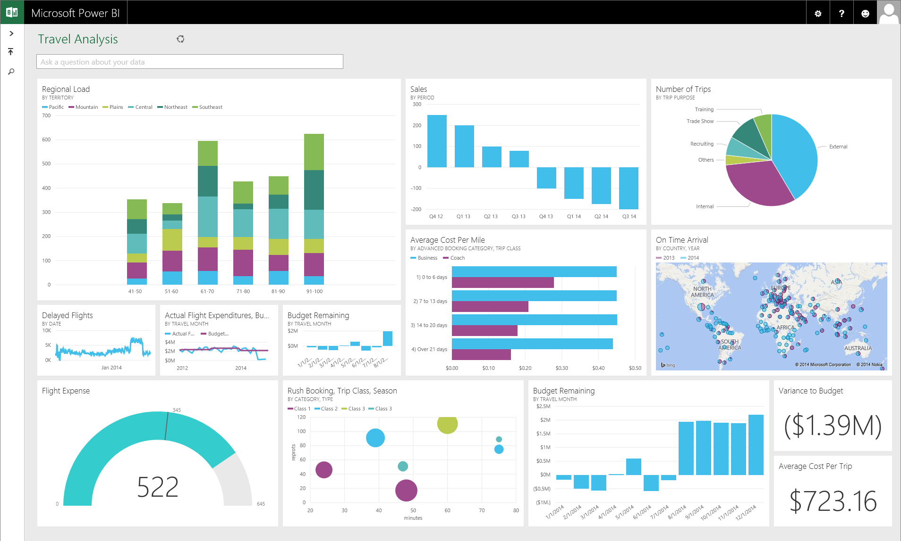

Dashboard development
Organize and present the existent data:
Visual representation
Support Business Decisions
Support Warehouse/Inventory management

Slide 3
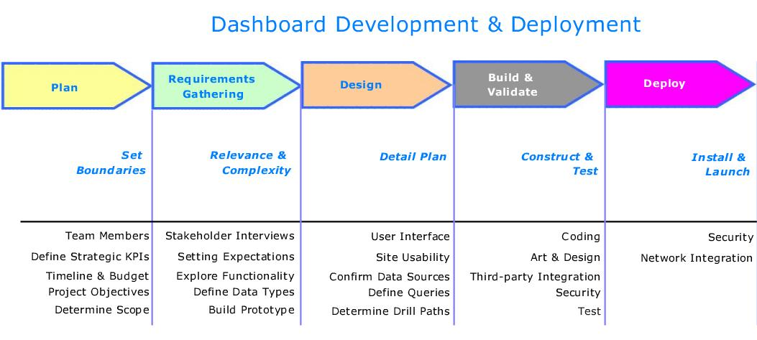
Agile methodology
The development steps in different sprints in order to:
- Adapt scope according needs
- Test different scenarios
- Simulate the market behavior while developing (real use cases)
Source: https://xcelsius.wordpress.com/2007/12/08/dashboard-development-life-cycle/

Slide 4
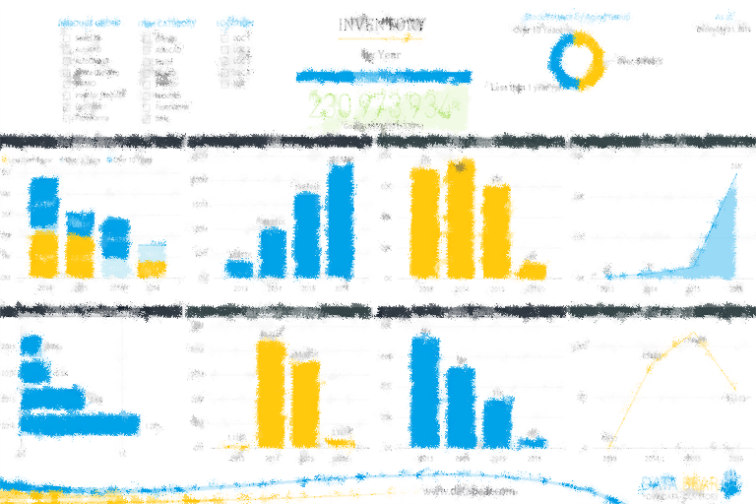
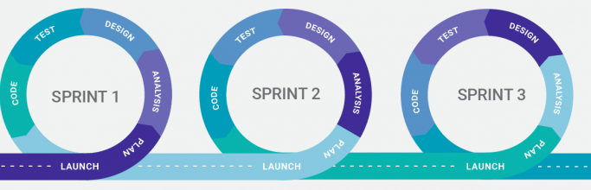

THANK YOU!
Source: https://powerbi.microsoft.com/fr-fr/partner-showcase/data-bear-inventory-analysis-solution/

